Slide 1
Pearson VUE
Authorization to Test (ATT) Purchase and Single Sign On Scheduling Process
For candidates testing worldwide

Slide 2
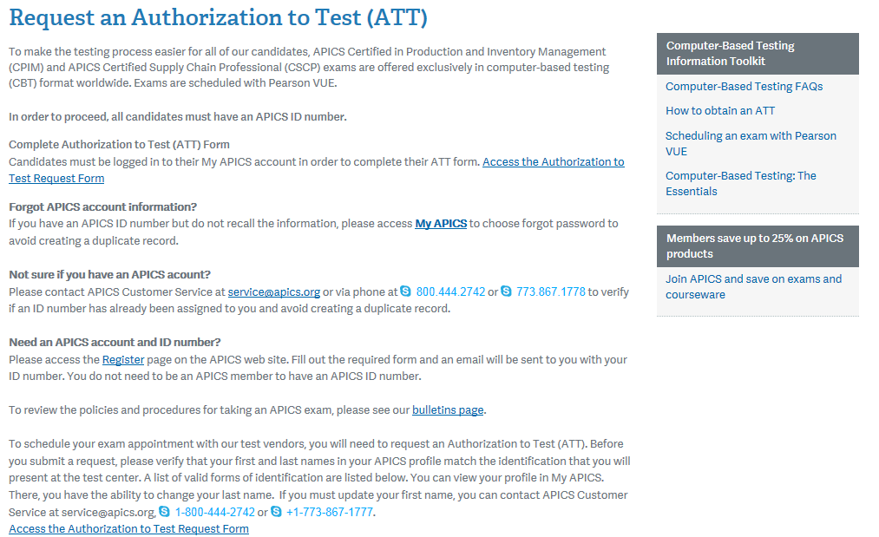
Purchasing an ATT and Scheduling Your Exam
Visit www.apics.org/att and log in.
Click to access the Authorization to Test Request Form.

Slide 3
Purchasing an ATT and Scheduling Your Exam
Select “Request a new Authorization to Test.”
(NOTE: This same process will apply for candidates who are updating their ATTs to choose a new window).

Slide 4
Purchasing an ATT and Scheduling Your Exam
Check the box to confirm that your information is correct and click “Continue.”

Slide 5
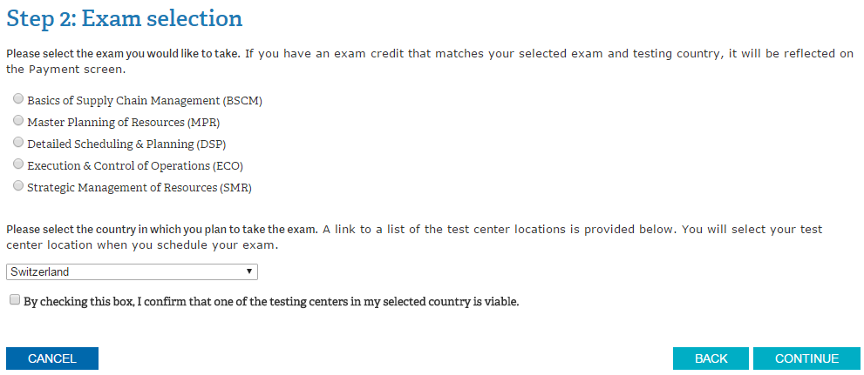
Purchasing an ATT and Scheduling Your Exam
Select the appropriate module and confirm the country in which you will test, then click “Continue.”

Slide 6
Purchasing an ATT and Scheduling Your Exam
Agree to the APICS Code of Ethics and testing policies.
Click “Continue.”

Slide 7
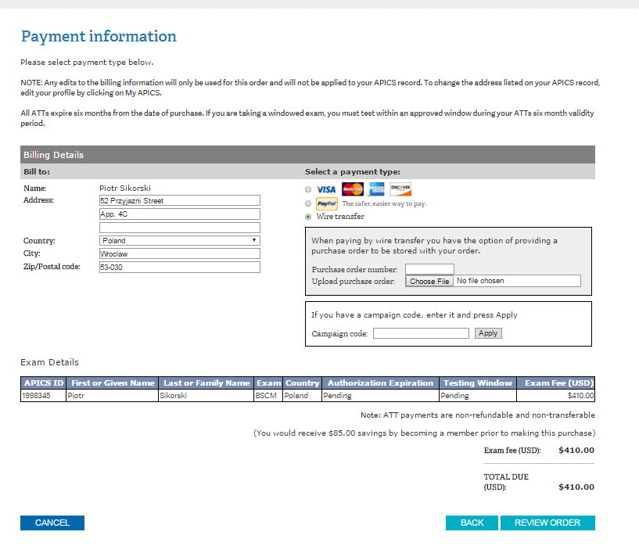
Purchasing an ATT and Scheduling Your Exam
Select the appropriate method of payment and click “Review Order.”

Slide 8
Purchasing an ATT and Scheduling Your Exam
Confirm the purchase of the Authorization to Test by clicking on “Submit Order.”

Slide 9
Purchasing an ATT and Scheduling Your Exam
Once the order is confirmed, you will be automatically redirected to Pearson VUE’s scheduling page.
Click on “Schedule this Exam” to select a center, date, and time.

Slide 10
Purchasing an ATT and Scheduling Your Exam
Select a test center and click “Next.”

Slide 11
Purchasing an ATT and Scheduling Your Exam
Select a date and time.
Click “Next.”

Slide 12
Purchasing an ATT and Scheduling Your Exam
Review appointment information for accuracy and click “Proceed to Checkout.”

Slide 13
Purchasing an ATT and Scheduling Your Exam
Confirm personal information and click “Next.”

Slide 14
Purchasing an ATT and Scheduling Your Exam
Confirm your agreement to the APICS and Pearson VUE policies and click “Next.”

Slide 15
Purchasing an ATT and Scheduling Your Exam
Confirm appointment details and click “Submit Order.”

Slide 16
Purchasing an ATT and Scheduling Your Exam
Review the appointment summary and print, if desired.
An email confirmation will also be sent.

Slide 17
Pearson VUE
Accessing Pearson VUE’s scheduling system

Slide 18
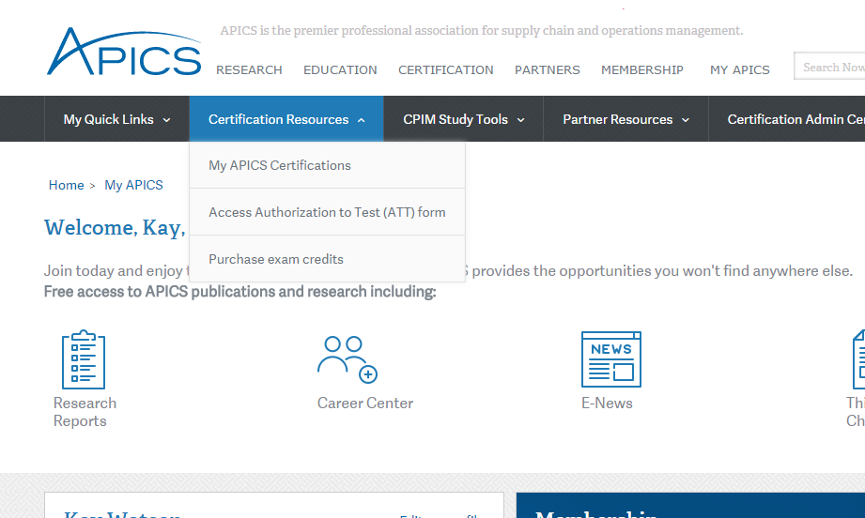
Scheduling your existing ATT
Visit www.apics.org/myapics and log in.
Click on the “Certification Resources” tab
Then select “My APICS Certifications”

Slide 19
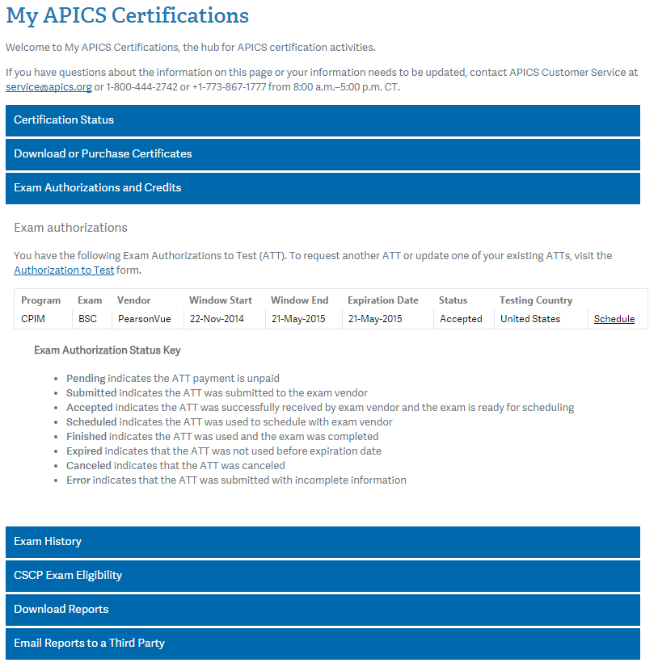
Scheduling your existing ATT
Select “Exam Authorizations and Credits”
Select the appropriate module and click “Schedule” to access Pearson VUE’s scheduling page.

Slide 20
Scheduling your existing ATT
Once the Scheduled link is clicked, you will be automatically redirected to Pearson VUE’s scheduling page.
Click on “Schedule this Exam” to select a center, date, and time.

Slide 21
Scheduling your existing ATT
Select a test center and click “Next.”

Slide 22
Scheduling your existing ATT
Select a date and time.
Click “Next.”

Slide 23
Scheduling your existing ATT
Review appointment information for accuracy and click “Proceed to Checkout.”

Slide 24
Scheduling your existing ATT
Confirm personal information and click “Next.”

Slide 25
Scheduling your existing ATT
Confirm your agreement to the APICS and Pearson VUE policies and click “Next.”

Slide 26
Scheduling your existing ATT
Confirm appointment details and click “Submit Order.”

Slide 27
Scheduling your existing ATT
Review the appointment summary and print, if desired.
An email confirmation will also be sent.

